Slide 1
Machine Learning and Artifical Intelligence
Lab 05 – SVMs and Evaluation Metrics
06/04/2021

Slide 2
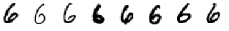
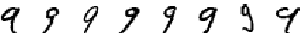

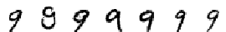
The problem under consideration
We want to recognize and classify images of handwritten digits:
https://en.wikipedia.org/wiki/MNIST_database
Consider images belonging to classes '6' and ‘9’:
They are similar between each other!
«6»
«9»

Slide 3
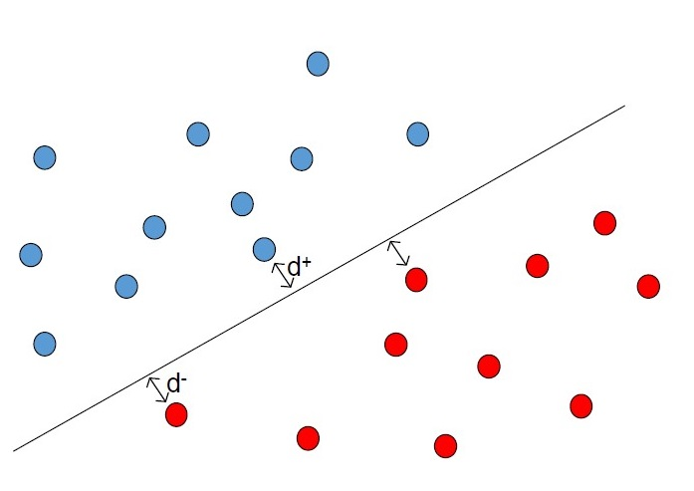
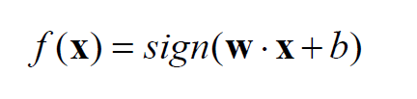
Support Vector Machine
Find the separation hyperplane between the 2 classes in order to maximize the margin, i.e. the minimum distance between d+ and d-
d+ and d- represent support vectors
the class of new data x:
Linearly Separable!
«6»
«9»

Slide 4
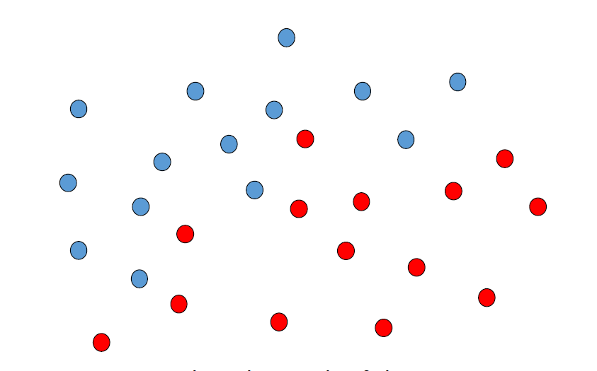

What if the problem is non-linear?
We can't find a separation hyperplane that divides all the samples correctly!
Introduction of Slack variables ${\text{ξ} }_{i}$ that allow some SV to exceed the margin and a parameter C indicating the wrong classification cost.
Kernel trick: Map data in another, higher-dimensional space through functions called Kernels.
Not Linearly Separable!

Slide 6
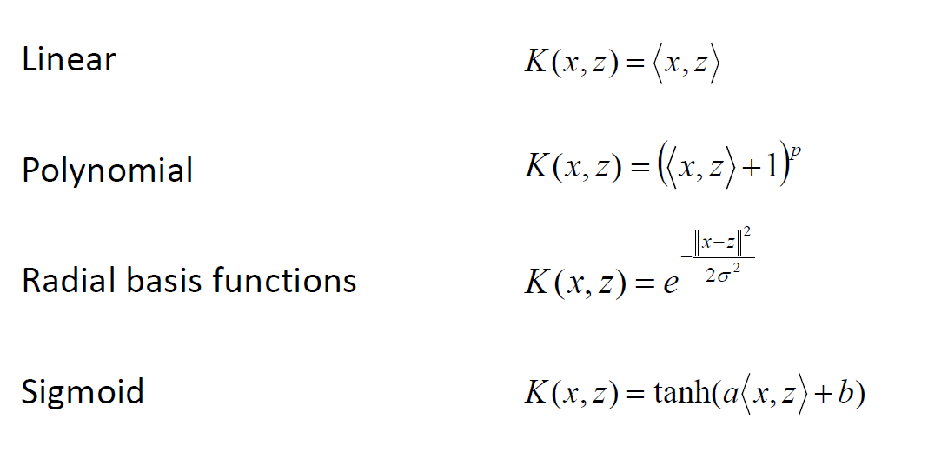
Examples of kernel functions

Slide 7
SVM in Sklearn
The SVM classification algorithm can be implemented through the Sklearn library (https://scikit-learn.org/stable/modules/generated/sklearn.svm.SVC.html#sklearn.svm.SVC )
How?
Model initialization (kernel specific): model = SVC(…)
Model fit (training to get w and b): model.fit()
Classification of test elements: model.predict(x)

Slide 8
Evaluation
It is imperative to understand how a classifier behaves quantitatively.
We need this information to:
Have absolute feedback: the goodness of a classifier/regressor. Have relative feedback: the goodness of a classifier/regressor compared to another.

Slide 9


Classification evaluation metrics
Accuracy: Number of correct predictions divided by the total number of predictions (dimensionality of the test set):
Error rate: Number of wrong predictions with respect to the total number of predictions:
$$accuracy= \frac{\# correct classifications}{\# classifications}$$
$$error_rate= \frac{\# incorrect classifications}{\# classifications}$$

Slide 10
Confusion Matrix
It allows you to understand where exactly the classifier makes mistake. Introduced initially for binary classification cases. Example:
Class A: Dog(positive) Class B: Not-dog (negative)

Slide 11
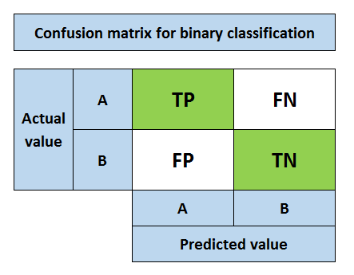
Type I error
Type II error

Slide 12
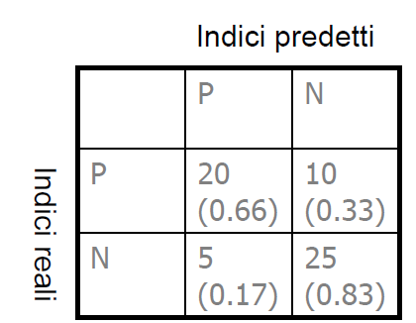
Confusion Matrix – Construction
With each prediction on the test set, I add +1 in the appropriate box (intersection between the index predicted by the classifier and the GT index) In the case of balanced classes we can normalize the values of the matrix, so that the rows sum to one. It's convenient to normalize values by rows and get percentages. The absolute count does contain more information though.
Predicted
R
e
a
l

Slide 13
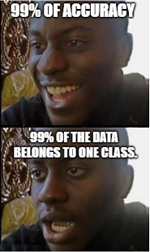
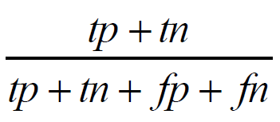
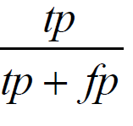
Confusion Matrix - Metrics
In the range [0,1]
Accuracy
Precision
Portion of cases predicted as positive that actually are. (If high) I take as positive only elements that actually are. (If low) I say everything is positive.

Slide 14
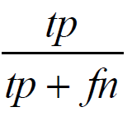
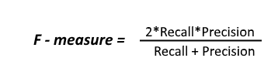
Confusion Matrix - Metrics
Recall (sensitivity)
Portion of all actually positive cases that have actually been classified as such (If high) I don't lose positive elements
(If low) I lose positive elements
F-measure
Combine precision and recall into one measure.

Slide 15
Regression tasks
In machine learning, we are not limited to classification tasks, even though they are common.
In regression tasks, the model learns to predict numeric scores, so the model output is a continuous variable.
In such a case, the metrics we mentioned before cannot be applied, because we are more interested in the magnitude of the error.

Slide 16
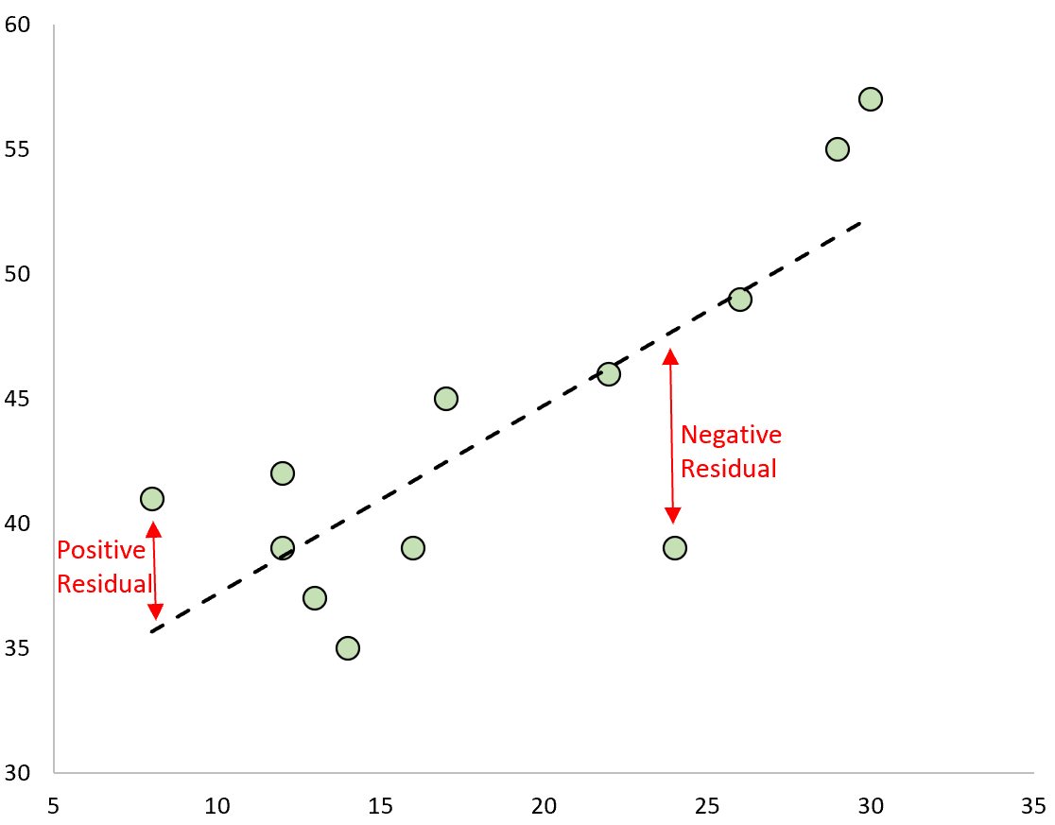
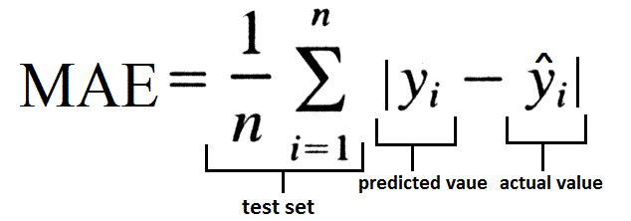
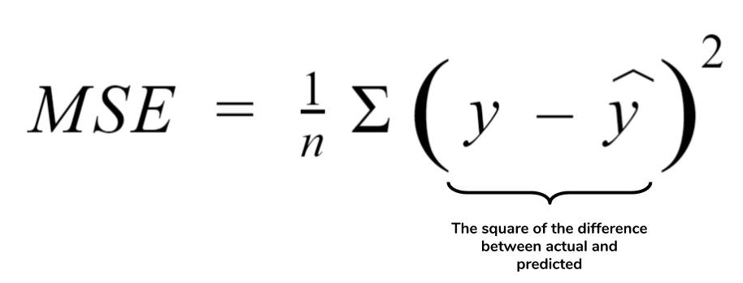
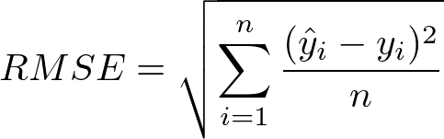
Regression evalution metrics

Slide 17
Evaluation metrics available in Sklearn
https://scikit-learn.org/stable/modules/classes.html#module-sklearn.metrics

Slide 18
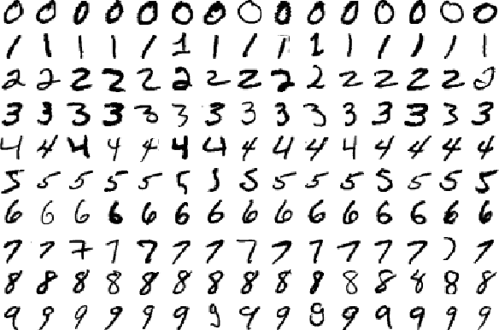
A different scenario
We must no longer classify only images belonging to classes '6' and '9' but all figures from '0' to '9'

Slide 19
From binary to multi-class
How do we move from binary classification to multi-class classification?
SVMs (and many other classifiers) don't support multi-class classification natively, we need to adopt different strategies.
One vs Rest:
Train K different classifiers, one for each class. Each of the classifiers considers a class as positive and the remaining as negative.

Slide 20
From binary to multi-class
One vs Rest strategy:
Given K classes, instantiate K different SVMs.
Train each of the K classifiers to recognize a particular class (the 3rd classifier will be trained to recognize class 3 and so on...)
Given the test elements, each of the K classifiers produces two probabilities:
Of belonging to the k-th class Of not belonging to the k-th class
The class corresponding to the test element is the one with the highest probability of membership. P.S: To output probabilities you must use the ‘predict_proba’ function in the Sklearn library.

Slide 21
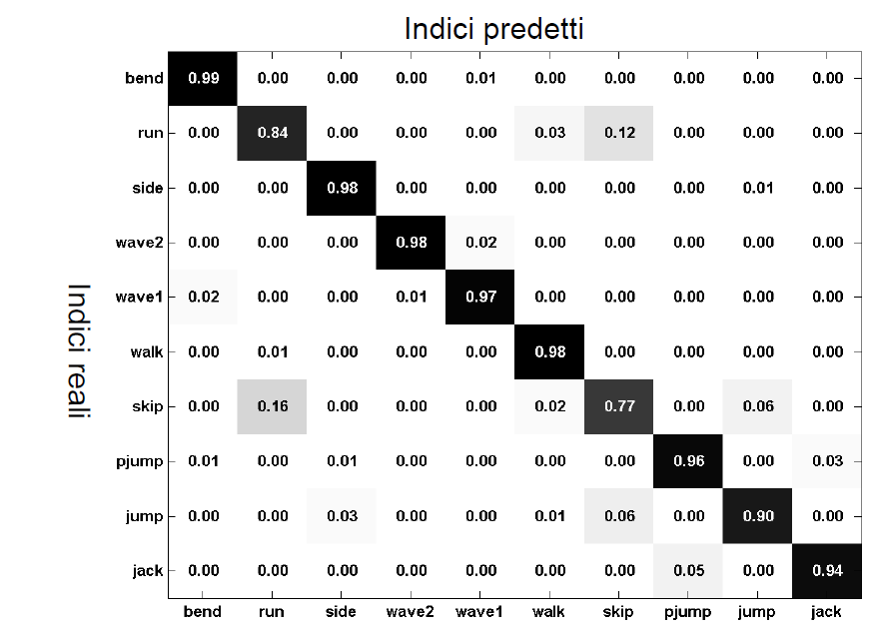
Confusion Matrix – K classes
Predicted
R e a
l

Slide 22
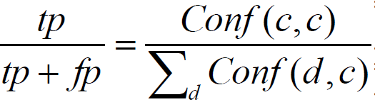
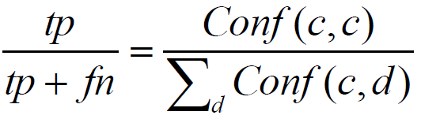
Confusion Matrix – K classes
Precision and Recall are associated with the single class.
Given the confusion matrix C x C
Precision:
Recall

Slide 23
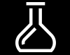
Exercises

